Slide 1
Developing a Machine Learning Model
ISDS 7075 Summer 2025 Taylor Kocher, Ryan McGiffin, Eric Lekas, Cameron Slaugh

Slide 2

About the Dataset
Chicago Police Department’s Citizen Law Enforcement Analysis and Reporting (CLEAR) system
Contains geographical information, outcome of crime (arrest) and/or whether it was a domestic dispute
Utilized 2016 data to create a Machine Learning (ML) model

Slide 3
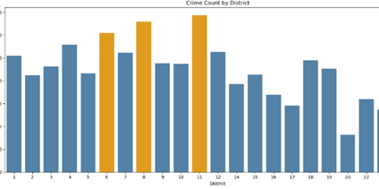
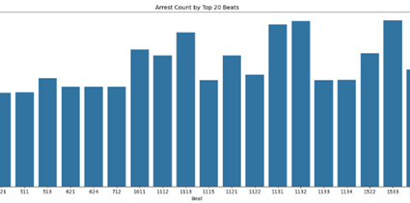
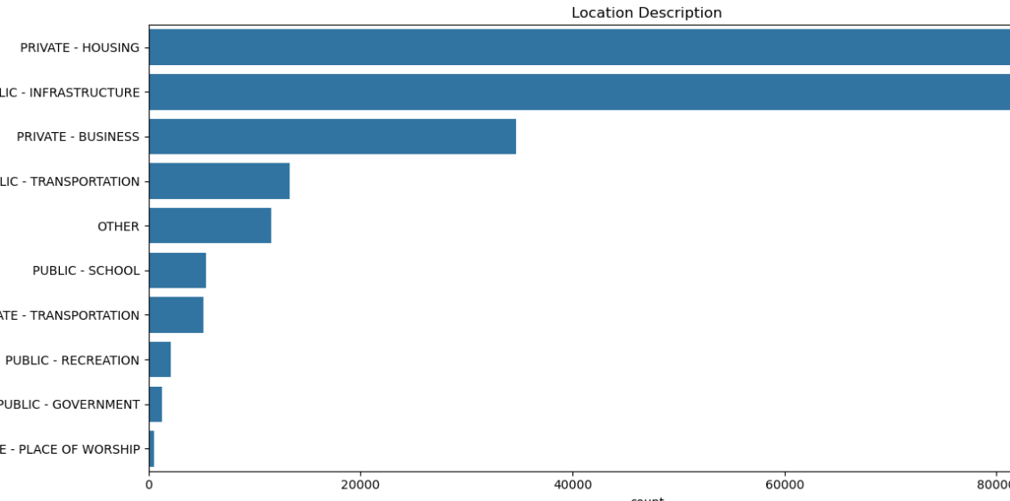
Frame the Problem
Data can be utilized to answer various business objectives
# of Crimes by Location
# of Crimes by District
# of Arrest by Beat
Main Objective of ML Model: predict the likelihood of an arrest based on various factors, such as type, location, and time of day

Slide 4
Initial Thoughts & Assumptions
Violent crimes to lead to more arrests
Drug-related crimes have a high number of arrests
Crimes that happen in the summer or during the afternoon result in more
School grounds would have more violent crimes
Most crimes happen in public places connected to infrastructure, as well as in private homes, along with a higher proportion of violent crimes
Notes:
Before building our model, we made several assumptions based on what we already know about crime and a first look at the data. We expected violent crimes to lead to more arrests because they are more serious and get more police attention. We also thought drug-related crimes would have a high number of arrests since police often target those specifically. Crimes that happen in the summer or during the afternoon were assumed to result in more arrests, since there are usually more people around and more police activity at those times. We believed that school grounds, especially public schools, would have more violent crimes, even if the total number of crimes there is low. Finally, we expected most crimes to happen in public places connected to infrastructure, as well as in private homes, and that these areas would also have a higher proportion of violent crimes compared to non-violent crimes. These ideas helped guide how we prepared the data and what we looked for in our model.

Slide 5

Data Wrangling
Dropped unnecessary columns
Updated data types
Removed rows with missing values
Binned data
Split testing and training data
Data visualization

Slide 6
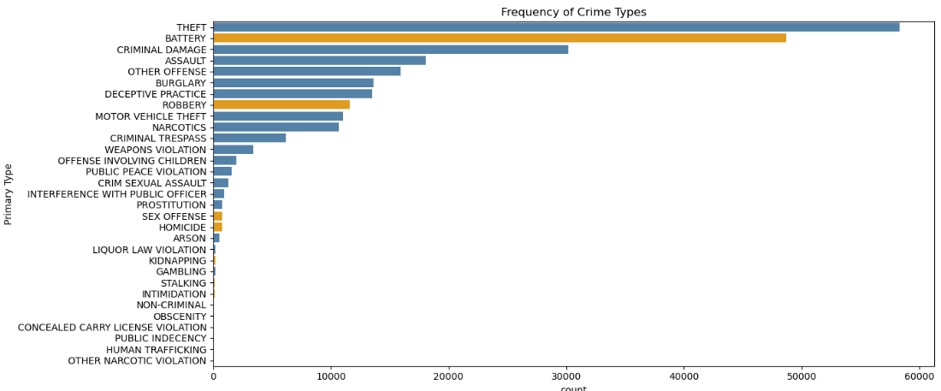
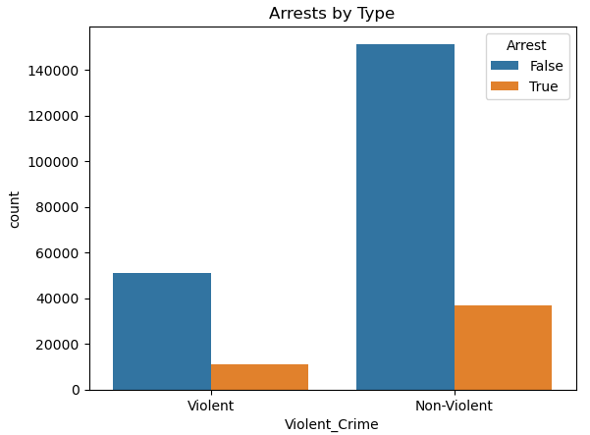
Exploratory Data Analysis
Arrests by Type
Most crimes do not result in arrests
Non-violent crimes retain highest frequency
Violent crimes show the highest arrest rate
Frequency of Crime
Theft is the most frequent crime
Battery is the most common violent crime (orange)
Notes:
Looking into the breakdown of violent and non-violent crimes, we began with a basic bar chart to help gain a general overview of the variable. The “arrests by type” chart showed most crimes do not result in arrests, non-violent crimes have the most volume, and violent crimes have the highest arrest rates. We then created a second chart to break down crime frequencies—non-violent crimes in blue and violent crimes in orange. This helped the group gain a deeper understanding of specific crimes that are most common, while reinforcing the previous finding that most arrests for crimes are non-violent.

Slide 7
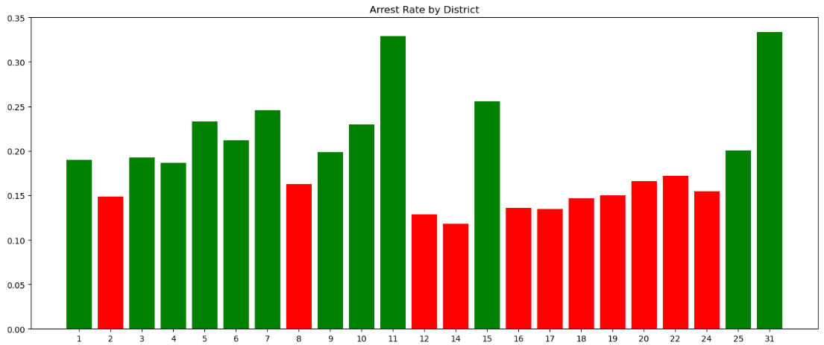
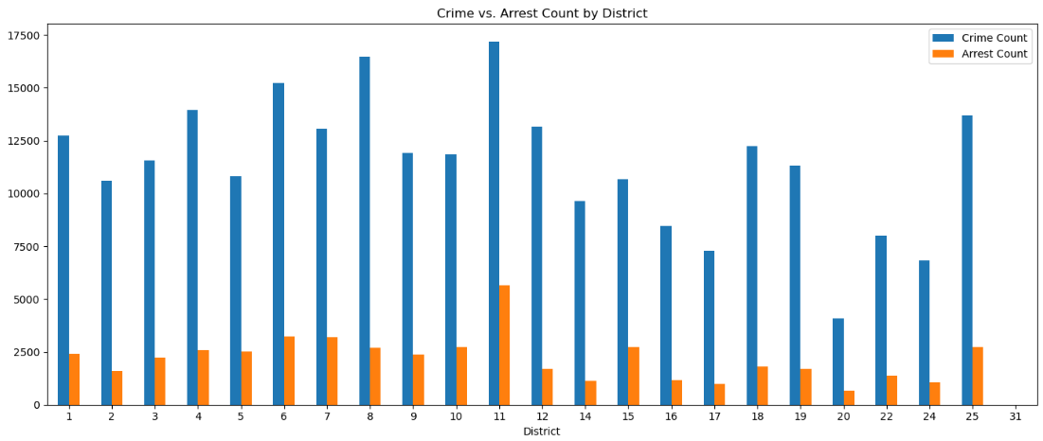
Exploratory Data Analysis
Crime vs. Arrest Count
Districts 6, 8, 11 each have crime counts greater than or equal to 1500
Districts 20 and 31 have the lowest volume of crime
Arrest Rate by District
Green bars indicate a “safe” district based on the median measure of arrest count / crime count
Overview of District and Crime graphs
District 11 has the highest arrest and crime count
High crime does not always mean high arrest rates
Helpful benchmarks for experimentation and model prep
Notes:
Continuing with the eda process, we analyzed how crime and arrest counts vary by district. The two graphs displayed work together: the first provides a side-by-side comparison of crime and arrest counts, while the second breaks this down into arrest rates by district-- using red to indicate whether a district falls below the median arrest count. Notably, district 11 has the highest crime and arrest counts but this does not always mean high arrest rates, as shown by district 8 with a similar number of crimes. While these graphs were not directly used in the feature engineering process, they offer valuable context. Should the predictive model underperform, we can revisit district level dynamics to dissect and potentially treat certain districts as outliers, but for now we are ready to move into the modeling phase.

Slide 8
Model Evaluation

Slide 9
Modeling Cycle
Preprocessing Pipeline
Model Selection
Initial Model Evaluation
Specify Model Parameters
Tuning
Determine Best Model
Notes:
The steps outlined in this slide were taken to prepare, select, evaluate, and determine the best model. We took a 6-stage approach. Throughout these stages, we applied a variety of selection and optimization techniques to efficiently and effectively determine the best model for our problem. The details of each stage are outlined in the following slides. Additionally, applying this structure to our approach facilitated seamless collaboration by clearly defining a framework. This was crucial to our success for several reasons. First, it allowed each team member to document their contributions and edits, while also easily understanding the contributions and edits of fellow teammates. Second, it provided a clear outline of the order of operations used in this cycle and kept the team calibrated with each other.

Slide 10
Preprocessing Pipeline
Handle
Handle Missing Values
Specify
Specify Imputation Methods
Scale
Scale Numerical Features
Transform
Transform Categorical Features
Notes:
A preprocessing pipeline was developed to prepare the data for the models we would decide upon. It accomplishes this in a few ways. First, it specifies how to handle missing values, whether they are to be ignored or imputed, and the method by which calculate imputed values. Next, categorical and numerical features are transformed for compatibility with selected models. Finally, we also use the pipeline to scale the numerical features being evaluated. This ensures that all numerical features carry equal weight and one will not influence the model more than any other.

Slide 11
Model Selection
Decision Tree
Logistic Regression
Gradient Boosting
Random Forest
Notes:
A mix of simple and more complex ensemble models were selected to be evaluated to allow for broad comparison. A decision tree model was selected for its simplicity. To contrast the decision tree model, we selected a logistic regression model. While decision trees are more susceptible to overfitting, logistic regression models are not. The same can be said for resilience to small nuance in the data. Logistic regression is more resilient to these small fluctuations in training sets. We then built upon the decision tree principle by selecting gradient boosting and random forest models. Gradient boosting and random forest models both use the decision tree approach but improve and iterate upon it in different ways. For example, a random forest model consists of a series of individual decision trees which are combined once developed to form the resulting final model. Gradient boosting models are also an ensemble of decision trees, but they iterate through combinations of decision trees while also developing new trees.

Slide 12
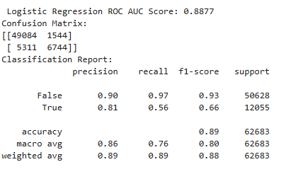
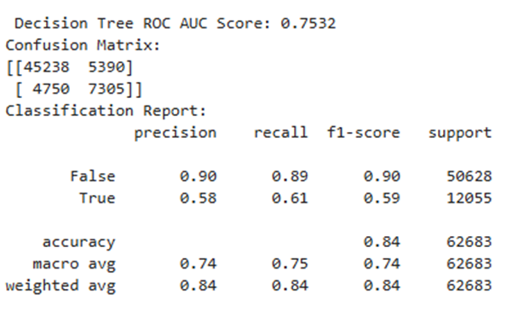
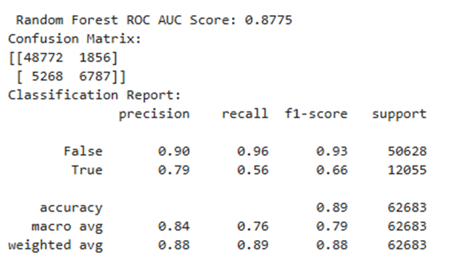
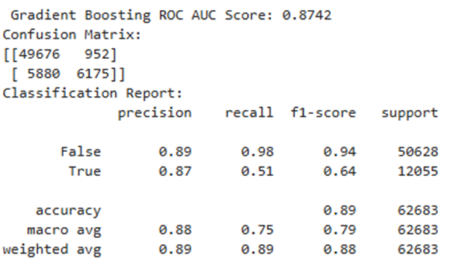
Model Results
Notes:
Modeling 1. First, we defined features by dropping columns that lacked predictive value and established arrest as our target variable. Next, we defined the train test split using 25% of the data for training and ensuring our random state was set to 42 for reproducibility. From there we established a preprocessing pipeline to ensure data preservation and proper conversion into a machine-readable format. Similarly, we also established a model pipeline to highlight how the models naturally fit the data before tuning. With this structure, we let the data speak for itself and enable room for modifications should we decide to make changes. Upon examination of the results, we see that logistic regression was the best model overall, however, none of these models were tuned, therefore, we cannot say with certainty this was the best model until tuning efforts are made.

Slide 13
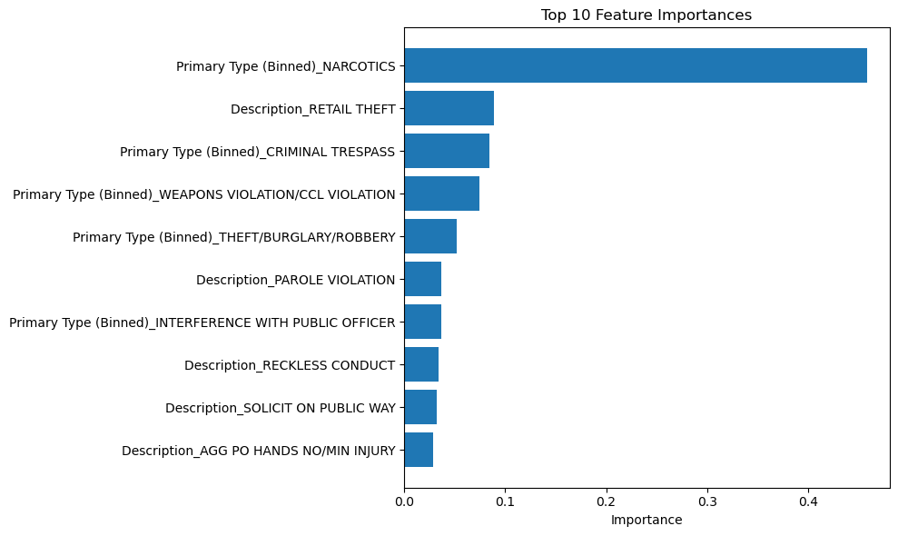
Feature Importance Evaluation
Primary Type produced the largest influence on model prediction.
Primary Type also occupies 4 of the top 5 most important features.
Significant drop in importance after 5th feature.
Description consistently has 2nd largest impact on prediction.

Slide 14
Specify Model Parameters
Parameter Grid Built
Parameters Determined and Specified
Iterate Upon Results
Notes:
We developed a parameter grid. This was done for a few different reasons. It allows for collaboration and error-proofing by rigidly organizing and structuring the parameters for each model. This allows team members to experiment in concert without creating noise in the working file or potentially altering code elsewhere by accident. It also allows for easier comparison of the hyperparameters for each model against one another. This allowed the team to manually iterate and gain an understanding for how the various models performance results were impacted by changing parameters before a later step of automated optimization.

Slide 15
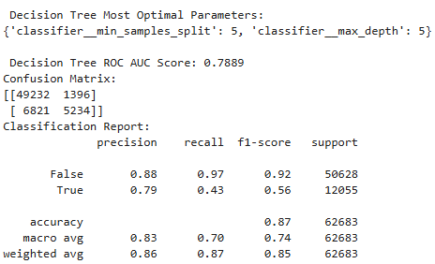
Modeling
Model Selection
Best model automatically selected during tuning evaluation
Tuned decision tree performed best
Logistic Regression Evaluation
Strongest fit for predicting arrest likelihood
Assumes linear relationships, matching data structure
Conclusion
Ensemble models did not outperform logistic regression—limited nonlinear complexities
Logistic regression recommended for real world implementation
Notes:
Behind the scenes, our code was formatted to select the best performing model based on optimal parameters, and in this case, the decision tree was the best tuned model with 5 samples split and a max depth of 5. However, for our primary objective—predicting the likelihood of an arrest, the logistic regression model proved to be a better fit. This aligns with the assumption that key features linearly influence arrest outcomes. While ensemble models like random forest or gradient boosting worked to capture hidden patterns, their performance suggests there were no significant nonlinear interactions in the data. In conclusion, logistic regression was the most reliable model for this classification task and would be the recommended choice for real world implementation.

Slide 16
Outcome
Understanding Arrest Patterns
Identifying arrest causes and patterns is a complex challenge
Predictive modeling is well-suited to generate insights
Real-World Impact
Supports data-driven safety strategies
Potential for more effective police resource allocation
Broader Implications
Classification is just the surface level—proactive crime prevention is the ultimate goal
Data science is very applicable to many real-world societal issues
Notes:
Identifying arrest causes and patterns is a complex, yet well suited challenge for predictive modeling, which can provide valuable guidance for improving safety and police resource allocation. Despite exploring advanced machine learning algorithms, we learned that simple models should not be overlooked. For future machine learning projects, modular pipelines will remain a core practice not only for interpretability purposes but also for flexibility in making modifications efficiently. Beyond predictive modeling, the real-world context of this problem is eye-opening. Since 2016, one in every six Chicago police officers has left the force. In 2018 alone, over 19,000 people were wounded in shootings, yet only 1,200 arrests have been made in connection with those incidents. We’re not just classifying outcomes; we’re aiming to guide proactive strategies in crime prevention. Our purpose for this assignment was not just about building a model but building a foundation which could support data-driven decisions and potentially save lives.

Slide 17
Citations
Ibm. (2025, June 4). What is Random Forest?. IBM. https://www.ibm.com/think/topics/random-forest
Lee, F. (2025, July 29). What is logistic regression?. IBM. https://www.ibm.com/think/topics/logistic-regression
scikit-learn developers . (n.d.). 1.10. decision trees. scikit learn. https://scikit-learn.org/stable/modules/tree.html
scikit-learn developers . (n.d.-c). Gradientboostingclassifier. scikit. https://scikit-learn.org/stable/modules/generated/sklearn.ensemble.GradientBoostingClassifier.html
Grimm, A., Schuba, T., & Boyle, A. (2025, March 14). “where’s my justice?” Only 6% of Chicago shootings lead to arrests, Sun-Times finds. Times. https://chicago.suntimes.com/the-watchdogs/2025/03/14/non-fatal-shootings-clearance-rate-chicago-police-cpd-statistics
Main, F., & Schuba, T. (2024, October 25). Chicago Police Department Exodus: New Cops are leaving in droves, Sun-Times Investigation finds. Times. https://chicago.suntimes.com/the-watchdogs/2024/10/25/chicago-police-department-exodus-suburbs-recruiting

